Slide 1
Chapter 14 – Association Rules and Collaborative Filtering
Data Mining for Business Analytics in R
Shmueli, Bruce, Yahav, Patel & Lichtendahl

Slide 2
What are Association Rules?
Study of “what goes with what”
“Customers who bought X also bought Y”
What symptoms go with what diagnosis
Transaction-based or event-based
Also called “market basket analysis” and “affinity analysis”
Originated with study of customer transactions databases to determine associations among items purchased

Slide 3
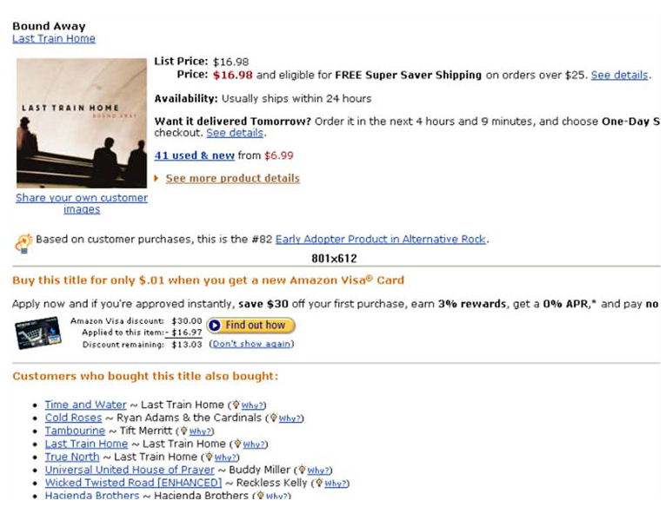
Used in many recommender systems

Slide 4
Generating Rules

Slide 5
Terms
“IF” part = antecedent
“THEN” part = consequent
“Item set” = the items (e.g., products) comprising the antecedent or consequent
Antecedent and consequent are disjoint (i.e., have no items in common)

Slide 6
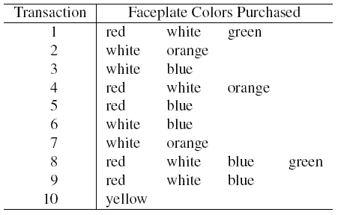

Tiny Example: Phone Faceplates

Slide 7
Many Rules are Possible
For example: Transaction 1 supports several rules, such as
“If red, then white” (“If a red faceplate is purchased, then so is a white one”)
“If white, then red”
“If red and white, then green”
+ several more

Slide 8
Frequent Item Sets
Ideally, we want to create all possible combinations of items
Problem: computation time grows exponentially as # items increases
Solution: consider only “frequent item sets”
Criterion for frequent: support

Slide 9
Support
Support for an itemset = # (or percent) of transactions that include an itemset
Example: support for the item set {red, white} is 4 out of 10 transactions, or 40%
Support for a rule = # (or percent) of transactions that include both the antecedent and the consequent

Slide 10
Apriori Algorithm

Slide 11
Generating Frequent Item Sets
For k products…
User sets a minimum support criterion
Next, generate list of one-item sets that meet the support criterion
Use the list of one-item sets to generate list of two-item sets that meet the support criterion
Use list of two-item sets to generate list of three-item sets
Continue up through k-item sets

Slide 12
Measures of Rule Performance
Confidence: the % of antecedent transactions that also have the consequent item set
Lift = confidence/(benchmark confidence)
Benchmark confidence = transactions with consequent as % of all transactions
Lift > 1 indicates a rule that is useful in finding consequent items sets (i.e., more useful than just selecting transactions randomly)

Slide 13
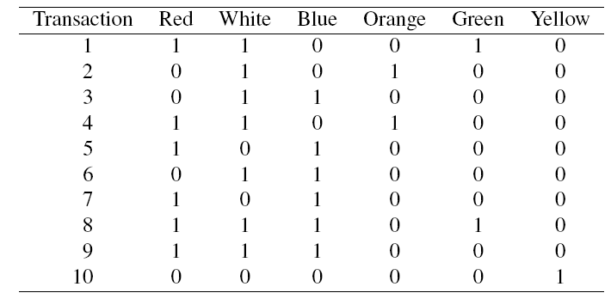
Alternate Data Format: Binary Matrix

Slide 14
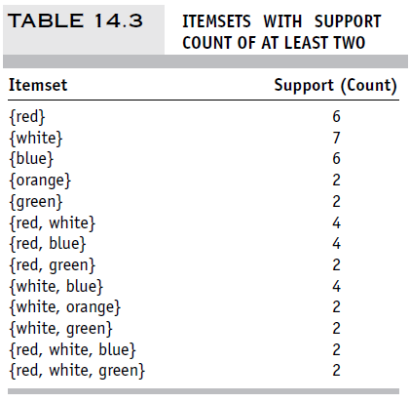
Support for Various Itemsets

Slide 15
Process of Rule Selection
Generate all rules that meet specified support & confidence
Find frequent item sets (those with sufficient support – see above)
From these item sets, generate rules with sufficient confidence

Slide 16
Example: Rules from {red, white, green}
{red, white} > {green} with confidence = 2/4 = 50%
[(support {red, white, green})/(support {red, white})]
{red, green} > {white} with confidence = 2/2 = 100%
[(support {red, white, green})/(support {red, green})]
Plus 4 more with confidence of 100%, 33%, 29% & 100%
If confidence criterion is 70%, report only rules 2, 3 and 6

Slide 17
Generating Rules in R
fp.df <- read.csv(“Faceplate.csv”)
# remove first column and convert to matrix
fp.mat <- as.matrix(fp.df[, -1])
# convert the binary incidence matrix into a transactions database
fp.trans <- as(fp.mat, "transactions")
inspect(fp.trans)
## get rules
# when running apriori(), include minimum support & confidence, & target as arguments.
rules <- apriori(fp.trans, parameter = list(supp = 0.2, conf = 0.5, target = "rules"))
output (sorted by lift)
P(green) if you use the rule
How much better your chances of getting a green are if you use the rule than if you select randomly
lhs rhs support confidence lift
15 {Red,White} => {Green} 0.2 0.5 2.500000
5 {Green} => {Red} 0.2 1.0 1.666667
14 {White,Green} => {Red} 0.2 1.0 1.666667
4 {Orange} => {White} 0.2 1.0 1.428571
6 {Green} => {White} 0.2 1.0 1.428571
13 {Red,Green} => {White} 0.2 1.0 1.428571

Slide 18
Interpretation
Lift ratio shows how effective the rule is in finding consequents (useful if finding particular consequents is important)
Confidence shows the rate at which consequents will be found (useful in learning costs of promotion)
Support measures overall impact

Slide 19
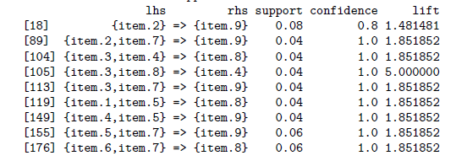
Caution: The Role of Chance
Random data can generate apparently interesting association rules. The more rules you produce, the greater this danger.
Rules based on large numbers of records are less subject to this danger.
Rules from some randomly-generated transactions:
Even chance data can produce high lift

Slide 20
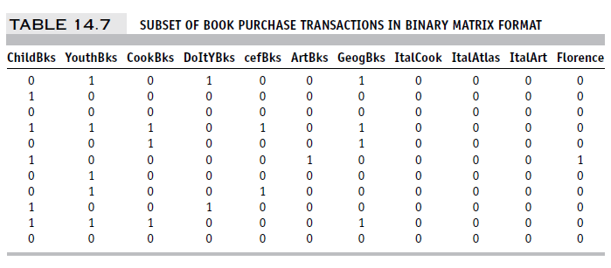
Example: Charles Book Club
Row 1, e.g., is a transaction in which books were bought in the following categories: Youth, Do it Yourself, Geography

Slide 21
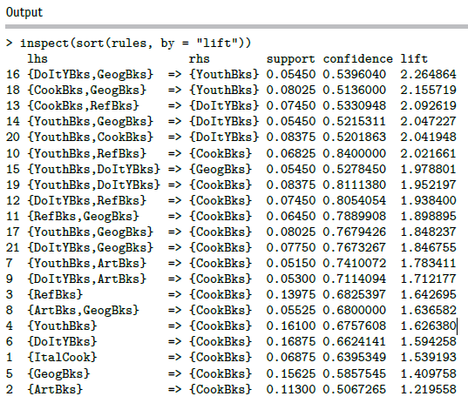
Rules Produced by apriori
Cautions:
Duplication (same trio of books)
No useful info!
rules <- apriori(books.trans,
parameter = list(supp= 200/4000, conf = 0.5, target = "rules"))

Slide 22
Summary – Association Rules
Association rules (or affinity analysis, or market basket analysis) produce rules on associations between items from a database of transactions
Widely used in recommender systems
Most popular method is Apriori algorithm
To reduce computation, we consider only “frequent” item sets (=support)
Performance of rules is measured by confidence and lift
Can produce a profusion of rules; review is required to identify useful rules and to reduce redundancy

Slide 23
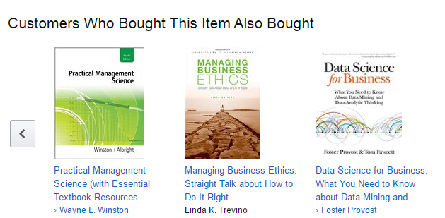
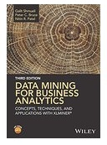
Collaborative Filtering
User based methods
Item based methods

Slide 24
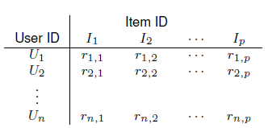
Item-user matrix
Cells are user preferences, r_{ij}, for items
Preferences can be ratings, or binary (buy, click, like)

Slide 25
More efficient to store as rows of triplets
Each row has the user ID, the item ID, and the user’s rating of that item
(U_{u}, I_{i}, r_{ui})

Slide 26
User-based Collaborative Filtering
Start with a single user who will be the target of the recommendations
Find other users who are most similar, based on comparing preference vectors

Slide 27

Measuring Proximity
Like nearest-neighbor algorithm
But Euclidean distance does not do well
Correlation proximity does better (Pearson)
For each user pair, find the co-rated items, calculate correlation between the vectors of their ratings for those items
Note that the average ratings for each user are across all products, not just the co-rated ones

Slide 28
Cosine Similarity
Like correlation coefficient, except do not subtract the means
“Cold start” problem: For users with just one item, or items with just one neighbor, neither cosine similarity nor correlation produces useful metric
Binary matrix? Must use all the data, not just the co-rated items.
This can add useful info – in the Netflix contest, information about which movies users chose to rate was informative.

Slide 29
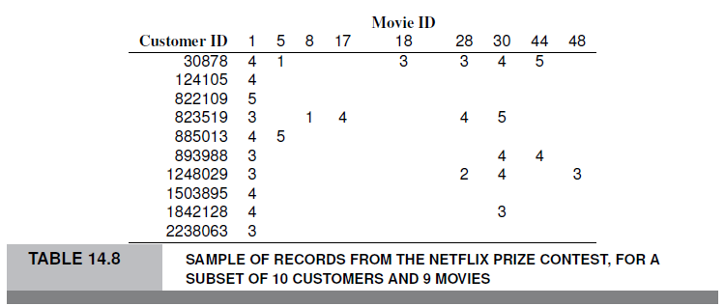
Example – Tiny Netflix subset
Consider users 30878 and 823519

Slide 30

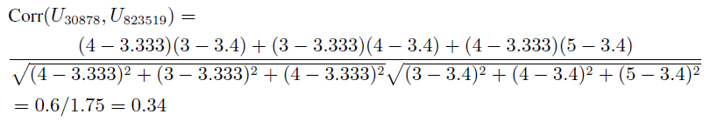
Correlation between users 30878 and 823519
First find average ratings for each user:
Find correlation using departure from avg. ratings for the co-rated movies (movies 1, 28 and 30):

Slide 31
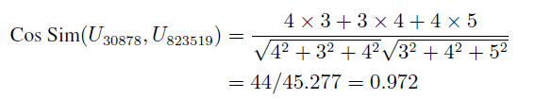
Find cosine similarity for same users
Use raw ratings instead of departures from averages:
Ranges from 0 (no similarity) to 1 (perfect match)

Slide 32
Using the similarity info to make recommendations
Given a new user, identify k-nearest users
Consider all the items they rated/purchased, except for the co-rated ones
Among these other items, what is the best one? “Best” could be
Most purchased
Highest rated
Most rated
That “best” item is the recommendation for the new user

Slide 33
Item-based collaborative filtering
When the number of users is huge, user-based calculations pose an obstacle (similarity measures cannot be calculated until user shows up)
Alternative – when a user purchases an item, focus on similar items
Find co-rated (co-purchased) items (by any user)
Recommend the most popular or most correlated item

Slide 34
R Code with recommenderlab
# simulate matrix with 1000 users and 100 movies
m <- matrix(nrow = 1000, ncol = 100)
# simulated ratings (1% of the data)
m[sample.int(100*1000, 1000)] <- ceiling(runif(1000, 0, 5))
## convert into a realRatingMatrix
r <- as(m, "realRatingMatrix")
library(recommenderlab)
# user-based collaborative filtering
UB.Rec <- Recommender(r, "UBCF")
pred <- predict(UB.Rec, r, type="ratings")
as(pred, "matrix")
# item-based collaborative filtering
IB.Rec <- Recommender(r, "IBCF")
pred <- predict(IB.Rec, r, type="ratings")
as(pred, "matrix")

Slide 35
Summary – Collaborative Filtering
User-based – for a new user, find other users who share his/her preferences, recommend the highest-rated item that new user does not have.
User-user correlations cannot be calculated until new user appears on the scene… so it is slow if lots of users
Item-based – for a new user considering an item, find other item that is most similar in terms of user preferences.
Ability to calculate item-item correlations in advance greatly speeds up the algorithm

Slide 36
Association Rules vs. Collaborative Filtering
AR: focus entirely on frequent (popular) item combinations. Data rows are single transactions. Ignores user dimension. Often used in displays (what goes with what).
CF: focus is on user preferences. Data rows are user purchases or ratings over time. Can capture “long tail” of user preferences – useful for recommendations involving unusual items

